Slide 1
P589-1 CEFX downsampled to 600 – resulting umaps
Thomas H. Edwards
20240814

Slide 2
Cells passing qc for each hashtag
hashtag | pool | donorId | stimulation | nCells_passQC
CerosalettiLab1059994_CD3CD28 | 2 | CerosalettiLab1059994 | CD3CD28 | 42
CerosalettiLab1059994_CEFX | 2 | CerosalettiLab1059994 | CEFX | 1437
CerosalettiLab1059994_Islet | 2 | CerosalettiLab1059994 | Islet | 114
CerosalettiLab1464776_CD3CD28 | 2 | CerosalettiLab1464776 | CD3CD28 | 160
CerosalettiLab1464776_CEFX | 2 | CerosalettiLab1464776 | CEFX | 1884
CerosalettiLab1464776_Islet | 2 | CerosalettiLab1464776 | Islet | 153
CerosalettiLab448473_CD3CD28 | 1 | CerosalettiLab448473 | CD3CD28 | 493
CerosalettiLab448473_CEFX | 1 | CerosalettiLab448473 | CEFX | 3111
CerosalettiLab448473_Islet | 1 | CerosalettiLab448473 | Islet | 240
CerosalettiLab632811_CD3CD28 | 1 | CerosalettiLab632811 | CD3CD28 | 604
CerosalettiLab632811_CEFX | 1 | CerosalettiLab632811 | CEFX | 1334
CerosalettiLab632811_Islet | 1 | CerosalettiLab632811 | Islet | 388
CerosalettiLab839987_CD3CD28 | 1 | CerosalettiLab839987 | CD3CD28 | 279
CerosalettiLab839987_CEFX | 1 | CerosalettiLab839987 | CEFX | 8612
CerosalettiLab839987_Islet | 1 | CerosalettiLab839987 | Islet | 263
CerosalettiLab942655_CD3CD28 | 2 | CerosalettiLab942655 | CD3CD28 | 439
CerosalettiLab942655_CEFX | 2 | CerosalettiLab942655 | CEFX | 12609
CerosalettiLab942655_Islet | 2 | CerosalettiLab942655 | Islet | 244
All CEFX hashtags downsampled to 600 cells.

Slide 3
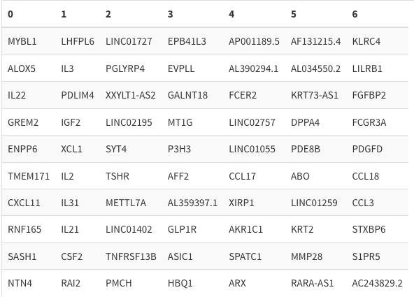
RNA umap downsampled – unintegrated

Slide 4
Scdeed ‘dubiousness’ designations

Slide 5
Rna umap clusters

Slide 6
HT on gex umap

Slide 7
Stimulation labels, downsampled umap

Slide 8
Mean treg & mean Tconv signatures

Slide 9
Mean of expression z-scores of tconv module

Slide 10
Mean of expression z-scores of treg module

Slide 11
Mean treg & mean Tconv signatures

Slide 12
Selected genes of interest
Other Treg/Tconv gene expression plots available on LabDB
https://labdb.benaroyaresearch.org/web/study/BSE0002196/files/66b65b504dc16fdb0a9691cc

Slide 13
Selected genes of interest
Other Treg/Tconv gene expression plots available on LabDB
https://labdb.benaroyaresearch.org/web/study/BSE0002196/files/66b65b504dc16fdb0a9691cc

Slide 14
Selected genes of interest
Other Treg/Tconv gene expression plots available on LabDB
https://labdb.benaroyaresearch.org/web/study/BSE0002196/files/66b65b504dc16fdb0a9691cc

